Slide 1
Building Node.js applications on Windows Azure
Aidan Casey

Slide 2


About me
Solutions architect at MYOB
Born in Dublin Ireland, living in Australia since 2006
16 years development experience working with Microsoft technologies
Currently working on a cloud platform for the next generation of MYOB’s accounting products – (C#.NET, REST, SQL Server, .NET 4.0)
@AIDANJCASEY
git@github.com:aidancasey

Slide 3
Agenda
Introduction to node.js
Review tooling, Azure SDK and development experience
Build and deploy a chat room application using Windows Azure SDK for Node.js
When should I use it?

Slide 4
Extra points to include
Add a slide for V8 benchmarking stats ?
Very small install and the core is tiny…
http://berb.github.com/nodejs-talk-chaosseminar/#37
http://s3.amazonaws.com/four.livejournal/20091117/jsconf.pdf
Good example non blocking operation
http://onteria.wordpress.com/2011/06/02/different-ways-to-read-in-files-using-node-js/

Slide 5
What is node.js?
Server side technology for building scalable network programs.
Executes server side JavaScript code using Google's V8 JavaScript engine
Asynchronous non-blocking programming model.
Highly scalable

Slide 6
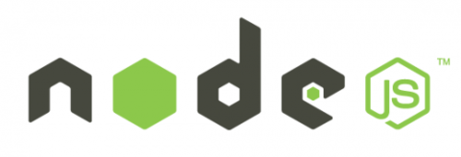
Timeline
July 2011
LinkedIn adopts node for mobile platform
port to Windows
IISNode
Nov 2011 Windows Azure support
EBay releases API built on node
Cloud9IDE azure
support
Nov 2010 Cloud9IDE
launches
Jan 2009
Created Ryan Dahl
April 2010 Heroku launches node support
Feb 2012
App Harbour
support
2009
2010
2011
2012
Oct 2011 node.js overtakes Ruby as most popular repo on gitHub
Walmart
Launch mobile site on node.js
July 2010
Yammer adopts node.js

Slide 7
Event Loop Processing Explained

Slide 8
Traditional Web server synchronous I/O model
Request 1001
Request 1
Web Server (with 1000 threads)
Request 1002
thread 1 processes the request
and blocks till completion
Request 1003
Response 1
Request 1000
thread 1000 processes the request
and blocks till completion
Requests queue up as blocked threads wait on server
Response 1000

Slide 9
Single threaded event loop model
Web Server
Request 1
Request 99999
Single threaded
event Loop
Response 5
Listen for requests
starts any I/O operations by
specifying a call back to execute
on completion
Continue to listen for requests
Response 1
Response 99999
“With node.js everything runs in parallel
Except your code ! ”
Notes:
In node.js only one piece of code is ever executing at any one time , everything is single threaded. Whenever you write code that will perform some I/O you wrap it in a function specifying a call back to execute when it completes.
Downside is if you write bad code you can block EVERYBODY.
The event loop co-ordinates what code executes next..
Under the covers a small number threads execute the I/O operations but you don’t have any control over this…

Slide 10
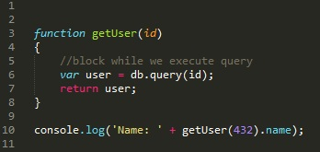
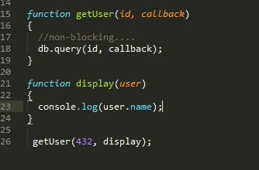
Don’t Block!
Since the event loop runs on a single thread you must avoid blocking calls at all times.
Blocking code blocks everything!
Blocking code….
Non-blocking code…

Slide 11
Demo : build a http webserver in 6 lines of code!

Slide 12
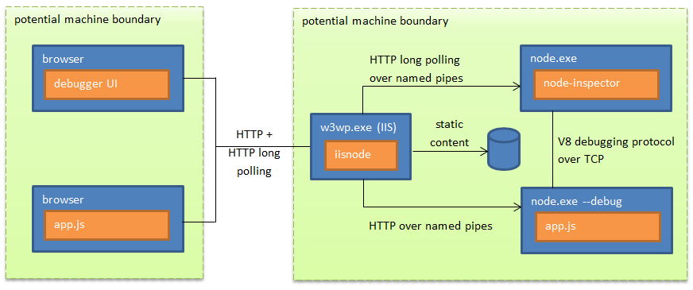
Debugging Node Apps
console.log(“my debug message”)
Node Inspector (Chrome/Safari/FireFox)
Notes:
cd C:\SAUG
New-AzureService DebugDemo
Add-AzureNodeWebRole
-- edit the file
Start-AzureEmulator -launch
-- add breakpoint
http://127.0.0.1:81/server.js/debug/
http://127.0.0.1:81
http://127.0.0.1:81/server.js/kill

Slide 13
Demo : Cloud9IDE
http://c9.io/

Slide 14

Node Package Manager
NPM registry contains over 8000 open source packages
Packages are easily installed from command line tool (node package manger)
Not all packages are cross platform (some target O/S specific features)
Beware of dependency hell !
Popular packages include…
Express (web dev framework), Socket.IO (real-time comms), Jade (templating engine), OAuth, Node-Static (serves static content)

Slide 15
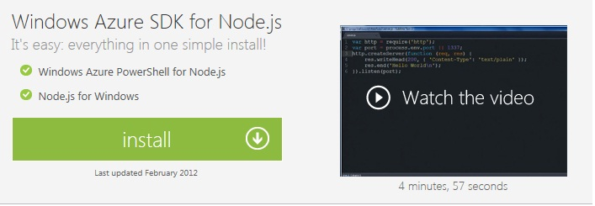
Windows Azure SDK for Node.js
Node.js
IISNode
NPM for WIndows
Azure Emulator
Azure PowerShell cmdlets

Slide 16
Windows Azure SDK for Node.js
Really easy to deploy (locally / cloud) using PowerShell cmdlets
Azure package gives access to
blob service, table service, queue service, service bus …
Currently you can’t deploy multiple node apps to the same instance ☹
You need to push up the source code for all packages you use
Debugging supported via IISNode & node Inspector

Slide 17
Deep dive: Building a real-time ChatRoom with Node.js , Sockets.io and Knockout.js
http://saugnodechatapp.cloudapp.net/

Slide 18
When should I use it?
chat / messaging type apps
real time apps ( stocks / ticker tape)
highly concurrent
single page apps with lots of asynchronous calls (Gmail etc.)
good for serving lots of dynamic content
Suits small development teams
applications that have a lot of concurrent connections and each request only needs very few CPU cycles

Slide 19
Thanks for listening !

